Slide 1
Using qualitative evidence in impact evaluations
Douglas Glandon
Senior Evaluation Specialist
Anca Dumitrescu
Senior Program Manager
QE Symposium
Brasília, Brazil, 10 October 2019
Notes:
Symposium title: using qualitative evidence to inform decisions in the SDG era
This presentation adds a slight plot twist and looks at the use of qualitative evidence in impact evaluations to inform decisions in the SDG era

Slide 2
Presentation outline
Impact evaluation and causal inference
Incorporating qualitative and mixed methods (examples from the field)
3ie online resources and repositories
Open discussion/Q&A

Slide 3
Presentation outline
Impact evaluation and causal inference
Incorporating qualitative and mixed methods (examples from the field)
3ie online resources and repositories
Open discussion/Q&A

Slide 4
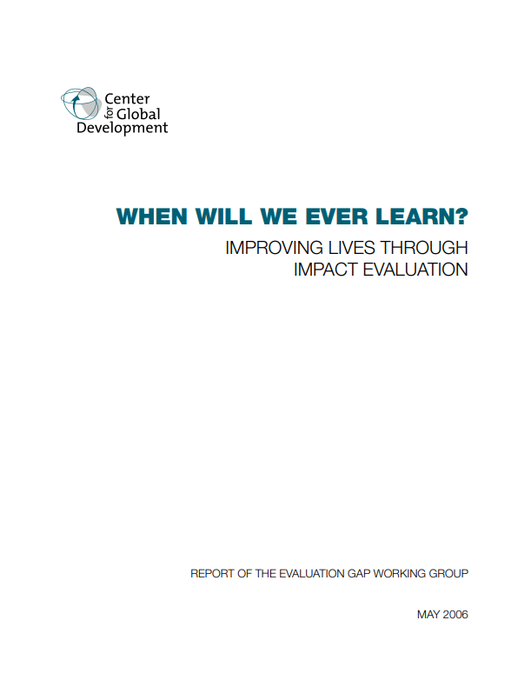
3ie’s Origin Story
Evaluation Gap Working Group highlights in 2006 that:
Though billions have been spent on aid, we know little about the impact. More and higher quality impact evaluations are urgently needed.
3ie created in 2008 to help answer the questions:
“
What works, for whom, why, and at what cost?
”
Notes:
Key message for this slide: two key parts to this (brief) origin story: 1) global community recognizes huge evidence gap related in part to the lack of high quality impact evaluations; 2) 3ie is created to help fill the gap
3ie works in multiple sectors:
-health
-nutrition
-WASH
-agriculture
-economic policy
-education
-energy
-social protection
-transportation
-urban development
-multisectoral

Slide 5
Evidence architecture and hierarchy of uses
Impact Evaluations
(including cost and implementation information)
Evidence Gap Maps
Systematic Reviews
All of the below in one place
(+ guidance, checklists, briefs, etc.)
Evidence Portals
User-friendly, easy access and stock-taking of evidence
Recommendations for new policies, other programs
Recommendations for the evaluated program
15
50
50
50
250
700
5000
Notes:
Each level builds on the other.
15 EGMs
50 SRs
50 countries with funded IEs
50 members
250 impact evals funded
700 SRs in our repository
5000 IE repositories

Slide 6
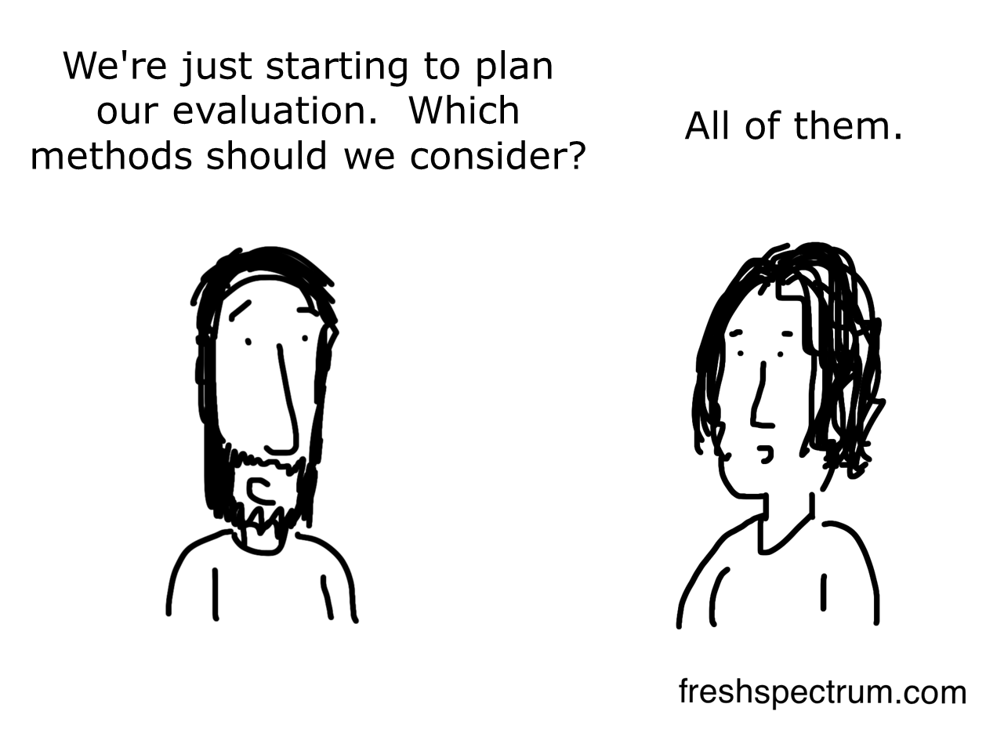
Impact evaluation in a “methodocracy”
All of them - as long as you choose a randomized controlled trial.
Adapted from:
http://freshspectrum.com/wp-content/uploads/2014/03/Consider-all-methods.png
Notes:
Key message for this slide: when some people hear the term “impact evaluation”, they think of a community of researchers who look only for questions that can be answered with randomized controlled trials – a sort of RCT “methodocracy”

Slide 7
“Pragmatic” thinking: questions drive methods
Research “pragmatism” de-emphasizes the philosophy of “truth”
Instead, the focus is on:
Choosing methods that best fit the research question(s), including both quantitative and qualitative
Research as a form of social action
Considering the implications of choosing one method vs. another
Morgan DL. Pragmatism as a paradigm for social research. Qual Inq. 2014;20(8):1045–1053.
Notes:
Key message for this slide: as an institution, 3ie adopts a “pragmatist” research paradigm in which the research questions drive the methods.
Re: social action and implications of choosing one method vs. another, comment on the limited resources and need for careful allocation in order to achieve the SDGs – impact evaluation has an important role to play
Implications – e.g., whether or not the research will convey voices of marginalized communities who normally go unheard – or thinking about how to balance precision and timeliness based on a window of opportunity for influencing policy

Slide 8
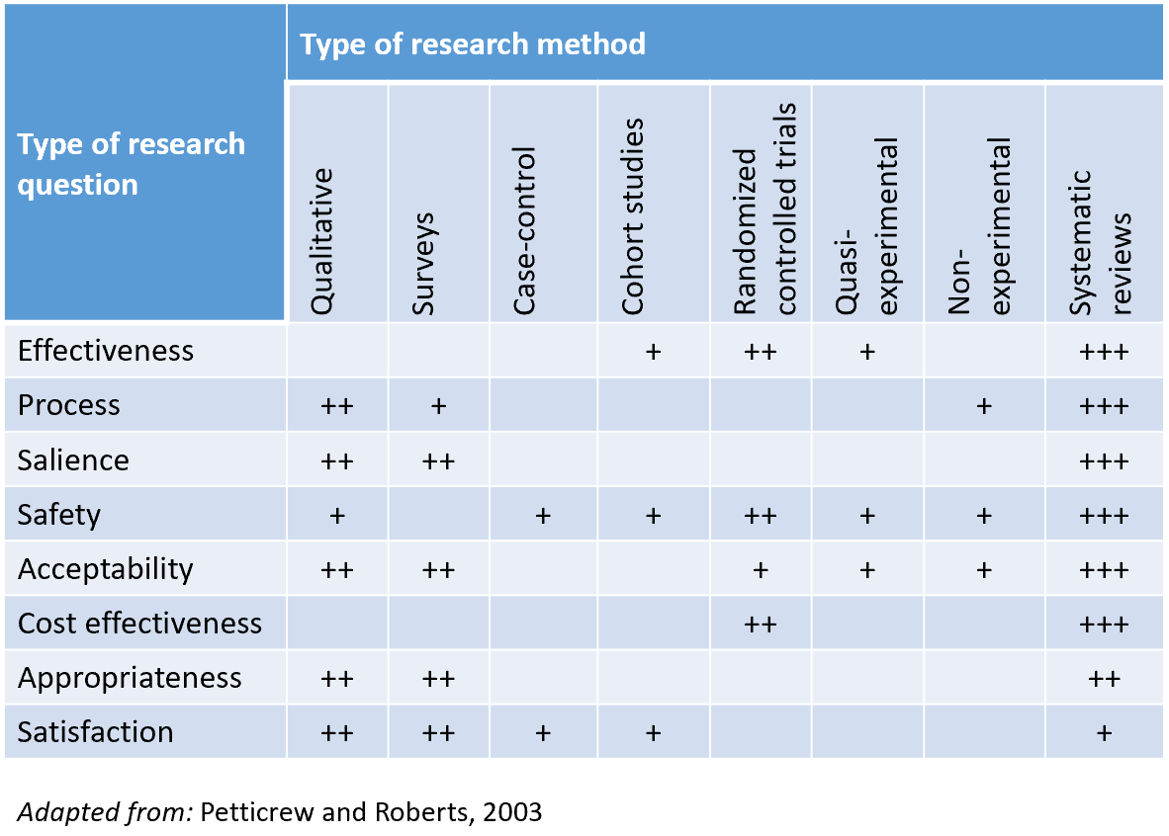
Example of matching methods to questions
Notes:
Key message for this slide: this is an illustrative example of how some researchers have reflected on the need to choose the right methods to match the research questions. As depicted in the diagram, some methods are more conducive to certain questions than others, and vice versa. Disclaimer: this table is neither comprehensive nor definitive.
Side note: cost-benefit and CEA also requires cost-side research (not only the impact estimates) and that this is woefully undersupplied currently and badly done. This is crucial to include in good rigorous research if you want it to inform policy decisions

Slide 9







What do we mean by impact evaluation?
Quantify changes in targeted outcomes that are attributable to the intervention (i.e., would not have otherwise happened)
Fundamental problem of causal inference
Outcome
vs.
With intervention
?
Without intervention
Time
Notes:
Key messages for this slide (follows along with animation):
Here we want to clarify what we mean by impact evaluation to make sure we’re all on the same page. This will already be familiar to some of you, so I will keep it brief.
The group on the left represents our target population. We want to measure the impact of a particular impact on this group.
Ideally, we’d like to be able to compare outcomes for this group when they receive the intervention (blue outline) to the same group if they didn’t receive the intervention (orange outline) (i.e., the counterfactual).
Unfortunately, we can’t observe both at the same time, which is the fundamental problem of causal inference.
So we end up comparing outcomes between different groups of people. Consequently, we have to try to manage selection bias in order to make sure we are comparing “apples with apples” to the maximum extent possible.

Slide 10
How do we measure what works?
Quantify changes in targeted outcomes that are attributable to the intervention (i.e., would not have otherwise happened)
Fundamental problem of causal inference
Methods:
-Randomized contr. trials
-Instrumental variables
-Regression discontinuity
-Propensity score matching
-Etc.
Outcome
vs.
With intervention
?
Without intervention
Time
Notes:
Randomized controlled trials are the methodologically “cleanest” way to establish a counterfactual so we can compare “apples with apples”, but this is sometimes impractical or not feasible
A variety of quantitative non-experimental methods address the same fundamental need for comparability:
Difference-in-difference
Instrumental variables
Regression discontinuity
Propensity score matching
Etc.
But these methods only tell part of the story

Slide 11
How do we measure what works?
Quantify changes in targeted outcomes that are attributable to the intervention (i.e., would not have otherwise happened)
Seek to understand and describe why, how, and in what contexts those changes occur, learn about unmeasured factors
Context (e.g., social, political, economic)
Motivations
Experiences
Unintended consequences
Complexity
Etc.
Outcome
vs.
With intervention
?
Without intervention
Time
Notes:
We also seek to understand and describe why, how, and in what contexts those changes occur.

Slide 12
Presentation outline
Impact evaluation and causal inference
Incorporating qualitative and mixed methods (examples from the field)
3ie online resources and repositories
Open discussion/Q&A

Slide 13
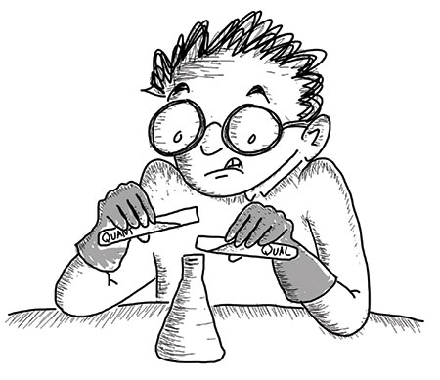
There is growing interest in mixed methods impact evaluations
“QUANT”
“QUAL”
“Mixing these methods should be safe.”
Illustration by Patrick Vinck
https://chance.amstat.org/2018/02/mixed-methods/
Notes:
Key messages for this slide:
There has been a substantial increase in the level of interest and number of publications on mixed methods in the past ten years or so, including empirical papers, theoretical papers, practical guidelines, sample protocols, design typologies, and so forth.
One of the key messages coming out consistently is that “mixed methods” means much more than just adding a quantitative method to a qualitative study or vice versa. Though people sometimes initially think of mixed methods as something that is inherently valuable because you are bringing together different and complementary methods with different strengths and weaknesses – so naturally you’ll end up with more valid or insightful findings. Unfortunately that’s not the case and mixed methods studies are often more difficult, expensive, and time-consuming than single-paradigm studies because you have to ensure rigor with each method and also develop a rigorous design and approach for integrating the methods.
Potential pitfalls: e.g.,
conducting some interviews and focus groups alongside quantitative data collection and then cherry-picking quotes to explain why an effect was observed or why it was not observed (may be partly due inadequate description of the settings, methods used to collect and analyze the data, examining rival hypotheses, looking for negative evidence, no justification for sampling, etc.)
Trying to quantize some qualitative data and then try to test for statistically significant differences between two or more groups in a small sample of data
In short, mixing methods has to be done carefully and requires adequate training.

Slide 14

Valuable experiences and lessons are emerging
E.g., 2018 CEDIL and 3ie “Mixing and matching” report, highlighting:
Good practices for integrating qualitative methods into quantitative impact evaluations and systematic reviews
Examples of specific applications of qualitative evidence in mixed methods impact evaluations
Notes:
Key messages for this slide: This CEDIL/3ie paper reviews recent work done to incorporate qualitative methods in impact eval., brings in expert opinion, outlines lessons for the way forward

Slide 15
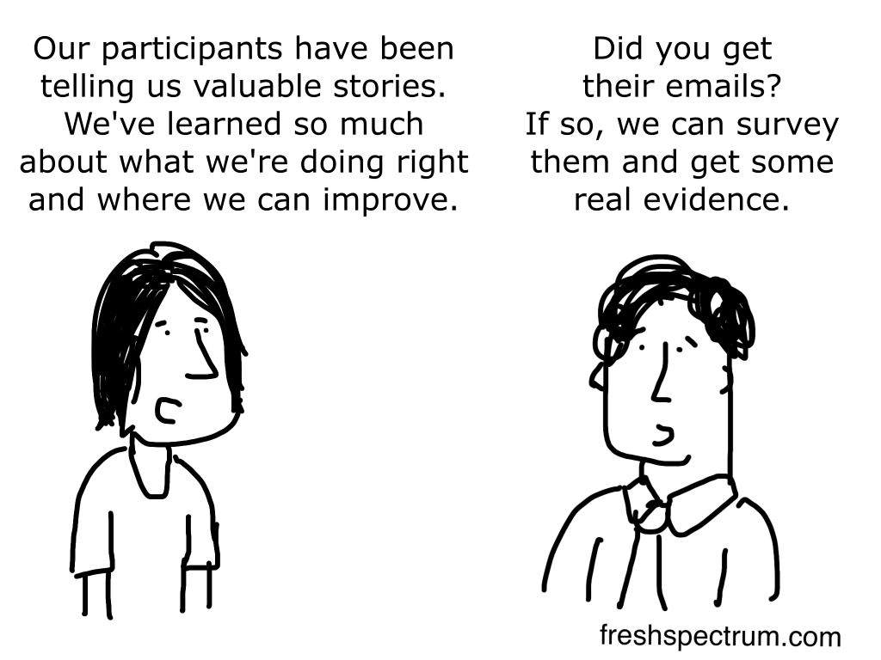
Research is moving beyond outdated perceptions
http://freshspectrum.com/wp-content/uploads/2014/12/Real-Evidence-1024x768.png
Notes:
Key message for this slide: One of the points noted in the introduction of the CEDIL report is that – like this slide - it still unfortunately common for authors to call their quantitative studies “mixed methods” when what all they are actually doing is adding qualitative quotes to justify findings from the quantitative analysis – or to spice up a presentation or report.

Slide 16
Good practices for using qualitative evidence in quantitative impact evaluations
Rigorous application of each method individually
Clear rationale for the integration of methods at key stages of the evaluation
Multidisciplinary teams with a shared evaluation approach
Adequate documentation (e.g., within the main report supplementary reports, appendices, etc.)
Acknowledge limitations of the integration and reflect on the transferability of findings and their policy implications
Notes:
Key messages for this slide: summarize key points from the CEDIL/3ie paper

Slide 17
Applications of qualitative evidence by study phase
Plan
Generate/refine theory
Conduct
Validate or triangulate quantitative findings
Interpret
Add contextual understanding to findings
Inform research questions to be asked
Choose research design, identification strategy
Design data collection approach, instruments
Investigate assumptions (e.g., about the Theory of Change)
Learn about population/beneficiary experiences
Identify heterogeneity, unintended consequences
Formulate better policy recommendations
External validity/transferability to other contexts
Raise new questions to guide future research
Notes:
Note to presenter: the CEDIL/3ie paper includes a subset of the applications of qualitative evidence listed in these slides. Also, some of the illustrative examples to be presented are not from that paper.

Slide 18
Applications of qualitative evidence by study phase
Plan
Generate/refine theory
Conduct
Validate or triangulate quantitative findings
Interpret
Add contextual understanding to findings
Inform research questions to be asked
Choose research design, identification strategy
Design data collection approach, instruments
Investigate assumptions (e.g., about the Theory of Change)
Learn about population/beneficiary experiences
Identify heterogeneity, unintended consequences
Formulate better policy recommendations
External validity/transferability to other contexts
Raise new questions to guide future research
E.g., identifying the “mother-in-law effect” in a Bangladesh nutritional counseling and supplementary feeding program
Notes:
White 2009: Bangladesh Integrated Nutrition Project
Context
-nutritional counselling and supplementary feeding for children with growth faltering or who were malnourished
-program targeted mothers of young children to bring them in to get weighed
Use of qual
-Reviewed anthropological literature
-Learned that for women in joint households (meaning they live with their mother- in- law) as a sizeable minority do, then the mother-in-law heads the women’s domain
-Led the research team to unpack the household roster section of the questionnaire to identify those women living with their mother in law
Indeed, project participation rates are significantly lower for women living with their mother- in-law in more conservative parts of the country.

Slide 19
Applications of qualitative evidence by study phase
Plan
Generate/refine theory
Conduct
Validate or triangulate quantitative findings
Interpret
Add contextual understanding to findings
Inform research questions to be asked
Choose research design, identification strategy
Design data collection approach, instruments
Investigate assumptions (e.g., about the Theory of Change)
Learn about population/beneficiary experiences
Identify heterogeneity, unintended consequences
Formulate better policy recommendations
External validity/transferability to other contexts
Raise new questions to guide future research

Slide 20
Applications of qualitative evidence by study phase
Plan
Generate/refine theory
Conduct
Validate or triangulate quantitative findings
Interpret
Add contextual understanding to findings
Inform research questions to be asked
Choose research design, identification strategy
Design data collection approach, instruments
Investigate assumptions (e.g., about the Theory of Change)
Learn about population/beneficiary experiences
Identify heterogeneity, unintended consequences
Formulate better policy recommendations
External validity/transferability to other contexts
Raise new questions to guide future research
E.g., alternative perspectives on the effects of take-home rations in a Cambodia school feeding study
Notes:
Context
-Take-home rations intervention, benefitting the poorest students in grades four through six,
Qual data
-Interviews with stakeholder and focus group discussions (beneficiaries and non-beneficiaries), tracer interviews with household members “graduating” from primary education cycles
Use of qual
-quant analysis of food consumption showed no positive effect of the program
-based on qual, THR beneficiaries appeared more resilient to food shortages (during the lean period, the THR allows families to spend less on rice), thus mitigating the loss of diet diversity during the lean season.
-At the household level, food consumption was analysed through the IDDS for THR beneficiaries only. This indicator doesn’t show a significant positive effect of the programme. However, it is believed that the period the survey was carried out negatively influenced the results. Qualitative interviews showed that THR allows beneficiaries to mitigate the loss of diet diversity they experience during the lean season. It is, therefore, a positive impact on the reduction of negative coping strategies.
-The study revealed higher asset scores for beneficiaries than for non beneficiaries, and lower representation of beneficiaries into the two poorest categories of households, in benefit of the two wealthiest ones. However, according to qualitative interviews, this difference is more likely to be due to a reduction of the sale of assets, as a coping strategy, than to an investment of eventual food savings or extra income in assets
-The qualitative data collection mainly focused on interviews with stakeholder and focus group discussions. Stakeholder interviews include staff from relevant line ministries, UN, NGO and the donor community. The purpose of these interviews is to collect data on more strategic issues that affect school feeding, such as national development plans, sectoral strategies or other specific interventions that may affect the school feeding interventions. The focus groups discussions will target both beneficiaries living in targeted communes and non-beneficiaries (within control groups). The purpose of these discussions is to understand and explain the causalities and assumptions of the school feeding programme, i.e. why is it successful, why do children attend school, to what extend does it have an effect on household economies and how does that affect dispositions related to education, etc. Topics and interview guides relate to the five categories of the household survey questionnaire (See Annex 7 for Topics list). Tracer interviews will be conducted with household members that have graduated successfully form primary education cycles. The purpose of this interview-approach is to „trace‟ the importance of school feeding among graduates.

Slide 21
Applications of qualitative evidence by study phase
Plan
Generate/refine theory
Conduct
Validate or triangulate quantitative findings
Interpret
Add contextual understanding to findings
Inform research questions to be asked
Choose research design, identification strategy
Design data collection approach, instruments
Investigate assumptions (e.g., about the Theory of Change)
Learn about population/beneficiary experiences
Identify heterogeneity, unintended consequences
Formulate better policy recommendations
External validity/transferability to other contexts
Raise new questions to guide future research
E.g., incorporating supply-side constraints and community heterogeneity into Theory of Change in India vaccination coverage study
Notes:
Context
-Uttar Pradesh, India:
-Community-led “hyper local” video education to increase vaccination uptake and coverage
Research design
-Mixed methods cluster-randomized controlled trial
Qual methods
-To inform prospective process evaluation, implementation fidelity
-FGDs, observation (of VHNDs) based on ToC
-iterative sampling for theoretical saturation
-Qualitative data were collected using semi-structured instruments designed for both FGDs and interviews, separately for health workers, mothers, and community members.
-Instruments were designed based on the study TOC and continually updated to reflect data collected
Qual uses
-Recognition of supply-side constraints (ANM training/skills – and the impact on demand, plus availability); also entrenched beliefs about vaccination and infertility, particularly among some older HH members and certain religious communities
-The intervention explicitly sought to change knowledge, attitudes, beliefs, and norms about immunization, which at baseline we believed to be significant constraints to immunization.
-The updated TOC and our findings illustrate that these may not have been the most significant constraints, or they cannot be addressed in isolation.
-Results of in-depth probing during FGDs and ASHA interviews suggest this belief continues to persist in some sub-communities in this district and is more strongly held among older generations, who tend to be decision-makers in traditional households, as well as in Muslim communities.

Slide 22
Applications of qualitative evidence by study phase
Plan
Generate/refine theory
Conduct
Validate or triangulate quantitative findings
Interpret
Add contextual understanding to findings
Inform research questions to be asked
Choose research design, identification strategy
Design data collection approach, instruments
Investigate assumptions (e.g., about the Theory of Change)
Learn about population/beneficiary experiences
Identify heterogeneity, unintended consequences
Formulate better policy recommendations
External validity/transferability to other contexts
Inform questions, methods for future research

Slide 23
Applications of qualitative evidence by study phase
Plan
Generate/refine theory
Conduct
Validate or triangulate quantitative findings
Interpret
Add contextual understanding to findings
Inform research questions to be asked
Choose research design, identification strategy
Design data collection approach, instruments
Investigate assumptions (e.g., about the Theory of Change)
Learn about population/beneficiary experiences
Identify heterogeneity, unintended consequences
Formulate better policy recommendations
External validity/transferability to other contexts
Inform questions, methods for future research
E.g., insights to improve take-up of an effective child development intervention in Mexico
Notes:
Context
-Mexico’s early education program (non-formal education programme providing training to pregnant women, parents (male and female) and caregivers of children between 0 and 4 years of age, living in highly marginalised, rural communities located across Mexico)
-community facilitators known as promotoras (‘promoters’).
Qual data
-interviews and focus groups with beneficiaries
Qual uses
-implementation fidelity
-many of the beneficiaries were participating, without having enough information about the benefits they and their children could receive, because acquaintances had recommended it.
-recommendations to inform redesign of a program that had been in place for almost two decades (and had positive impacts on both parenting practices and child development outcomes)
-Implementation of the PEI for almost two decades without an impact evaluation has resulted in the institutionalisation of practices and criteria without adequate evidence to support them. Based on the information collected (qualitative and quantitative), the interpretation of findings and interactions with public officials, we identified the following implications as key aspects to be considered in a potential redesign of the programme

Slide 24
Applications of qualitative evidence by study phase
Plan
Generate/refine theory
Conduct
Validate or triangulate quantitative findings
Interpret
Add contextual understanding to findings
Inform research questions to be asked
Choose research design, identification strategy
Design data collection approach, instruments
Investigate assumptions (e.g., about the Theory of Change)
Learn about population/beneficiary experiences
Identify heterogeneity, unintended consequences
Formulate better policy recommendations
External validity/transferability to other contexts
Inform questions, methods for future research
E.g., proposing alternate quantitative measures used as a proxy for women’s bargaining power in Zambia
Notes:
Context
-Women’s empowerment (child grant program); a poverty-targeted, unconditional transfer given to mothers or primary caregivers of young children aged zero to five.
Qual data
-The qualitative component consisted of 30 IDIs with women and 10 IDIs with male partners or other decision makers in the household of the women interviewed, collected at one point in time in the Kaputa District
-The women and their partners were purposefully sampled from the longitudinal quantitative sample stratified on three indicators: (1) marital status (married and cohabiting versus unmarried), 6 (2) changes in quantitative measures of decision making over time (as a proxy for changes in women’s empowerment), and (3) treatment or control group
Qual uses
-The combined methods show that there is significant room for improvement of measurement of empowerment, including of women’s decision-making indicators. In particular, findings show that although women often state they make decisions (either solely or jointly), they also acknowledge that if there is a disagreement or difference of opinion women’s preferences are often second to men’s, calling into question the validity of empirical measures to accurately capture the concept of ‘‘the ultimate decision maker.” In addition, research suggests that men and women differ in their perceptions of decision making, indicating a divergence of opinion or other sources of bias with creates conflicting reports

Slide 25

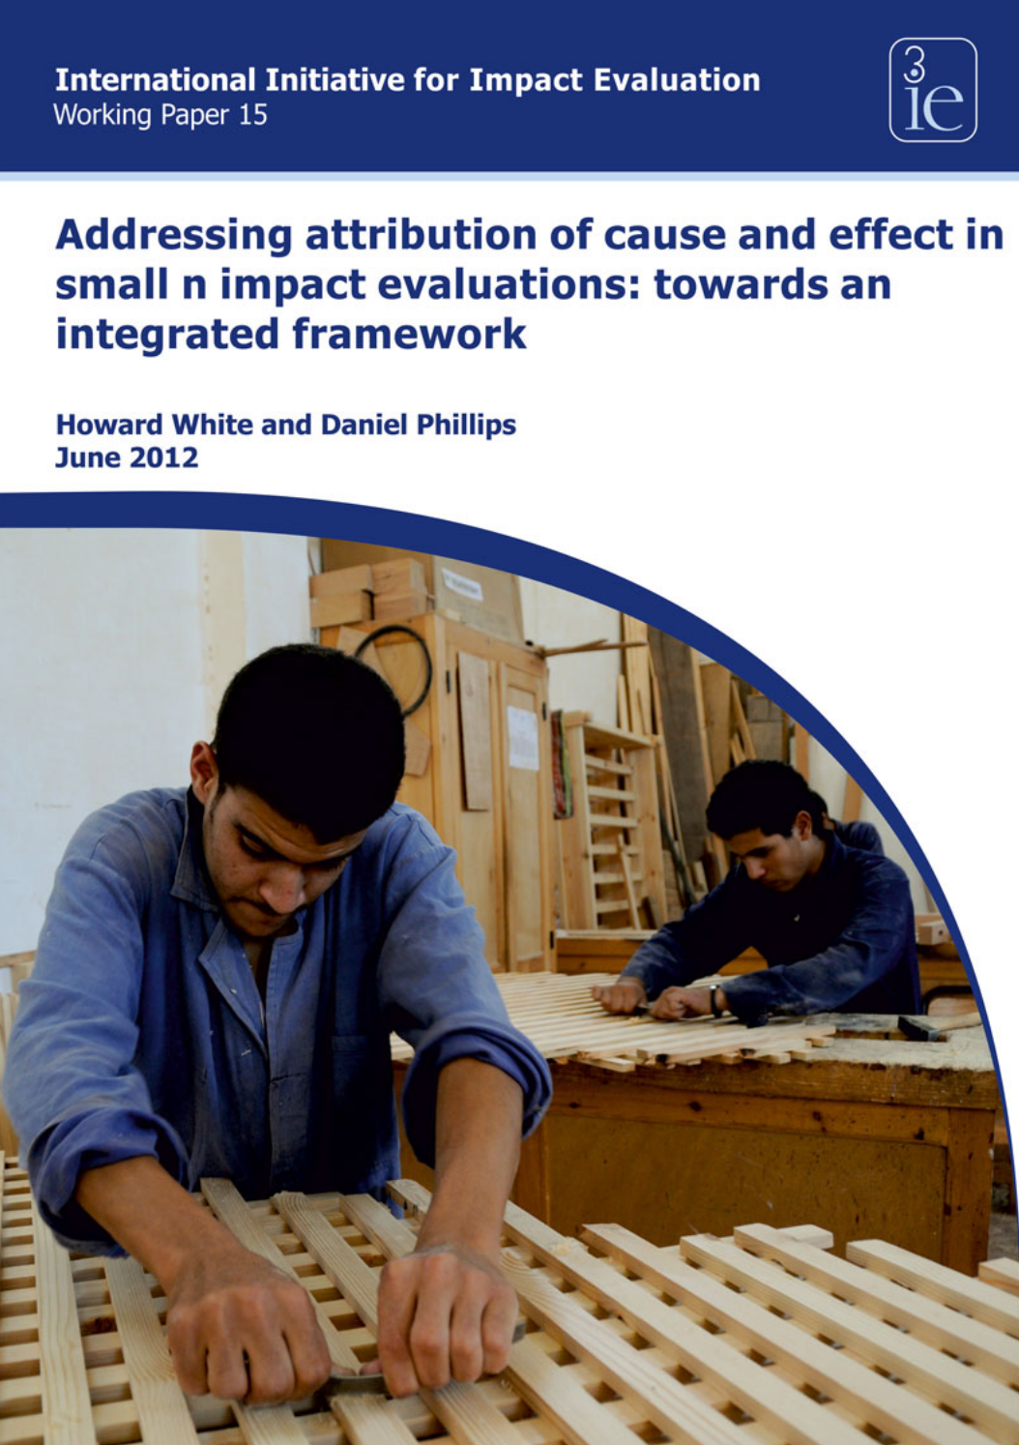
(Some) next steps for qualitative evidence in IE
Cont’d innovation in mixed methods designs for impact evaluations (IEs)
Broader use of qualitative evidence in systematic reviews (SRs)
Common definitions and reporting guidelines for mixed method IEs & SRs
Widespread adoption of critical appraisal tools for mixed method IEs & SRs
Integration of implementation research and impact evaluations
Small “n” methods, e.g.,
Realist evaluation
General elimination methodology
Process tracing
Contribution analysis/contribution tracing
Qualitative comparative analysis
Continue to enhance research transparency
Notes:
Key messages for this slide: this is an exciting and expanding area. Lots of opportunity for innovation going forward. Some examples are listed in the slide.
Mention that the 3ie website contains resources related to each of the listed items (including repositories for IEs, SRs, and EGMs).
Small n: available data are insufficient for testing statistical differences in outcomes
Realist evaluation (mixed methods):
-realist paradigm (i.e, there is a “real” world independent of our interpretations of it)
-when a program is implemented, it is testing a theory
-REs set out to test a Middle Range Theory detailing how the mechanisms should cause desired outcomes (“mechanisms + context = outcomes”)
-map out conjectural “mini-theories” called Context Mechanism Outcome (CMO) configurations
-mixed methods data gathered to revise, invalidate, or substantiate CMOs
General elimination methodology (mixed methods):
-systematically identifying and then ruling out causal claims (based on Lists of Possible Causes)
-each putative cause should have its own set of footprints or “modus operandi” (a set of conditions, concurrent events, etc.)
-all causes without an MO footprint are ruled out
Process tracing:
-identify intervening causal processes or mechanisms
-generate a number of competing hypotheses about how an intervention may connect to an outcome (with causal mechanisms)
-identify what should be observed if each hypothesis is true
Contribution analysis (plausibility, fidelity, verified ToC, accounting for other factors)
Note to presenter: “Thematic synthesis” (Thomas & Harden 2008) is an example of a qualitative method used to incorporate qual evidence into systematic reviews; others are also innovating in this area.
Qualitative Comparative Analysis (QCA) is a methodology that enables the analysis of multiple cases in complex situations
-helps explain why change happens in some cases but not others
-mixed methods, case-based approach
-for use with 10 to 50 cases (too few for statistical analysis)
-start with ToC, identifying outcomes (cases with and without), identify factors (based on ToC), score the factors, analyze (fsQCA), interpret
-
Note to presenter re: transparency: 3ie already subjects to quantitative studies to replication (PBR) and that ensures that de-identified data are made publicly available, we are now working on a pilot with QDR/Syracuse University to develop guidelines for how to do something equivalent for qualitative data (much more difficult to de-identify IDIs, FGDs, videos and the like!!)

Slide 26
Applications of qualitative evidence by study phase
Plan
Generate/refine theory
Conduct
Validate or triangulate quantitative findings
Interpret
Add contextual understanding to findings
Inform research questions to be asked
Choose research design, identification strategy
Design data collection approach, instruments
Investigate assumptions (e.g., about the Theory of Change)
Learn about population/beneficiary experiences
Identify heterogeneity, unintended consequences
Formulate better policy recommendations
External validity/transferability to other contexts
Raise new questions to guide future research

Slide 27
Presentation outline
Impact evaluation and causal inference
Incorporating qualitative and mixed methods (examples from the field)
3ie online resources and repositories
Open discussion/Q&A

Slide 28
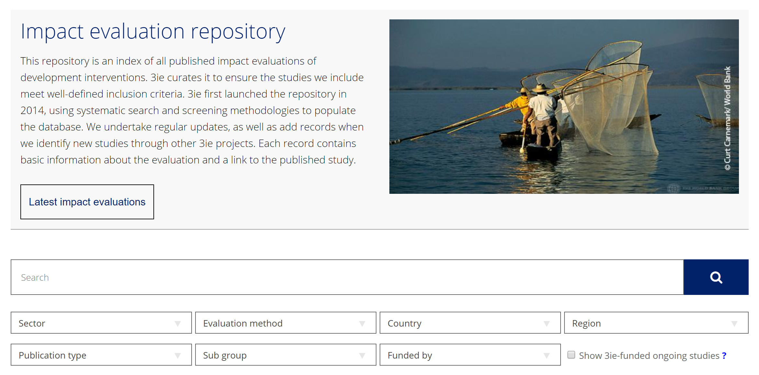
Keep up with IE mixed methods from the field…
4,803 impact evaluations as of Oct. 8, 2019; 188 from Brazil

Slide 29
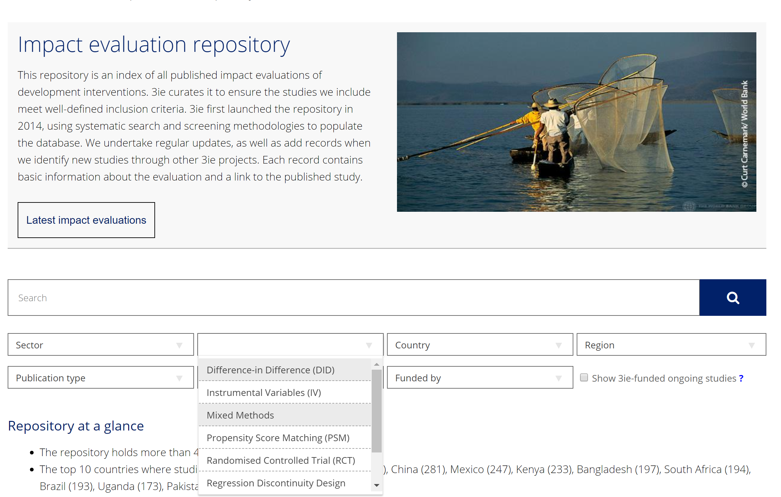
Keep up with IE mixed methods from the field…
85 mixed methods IEs
as of Oct. 2019

Slide 30
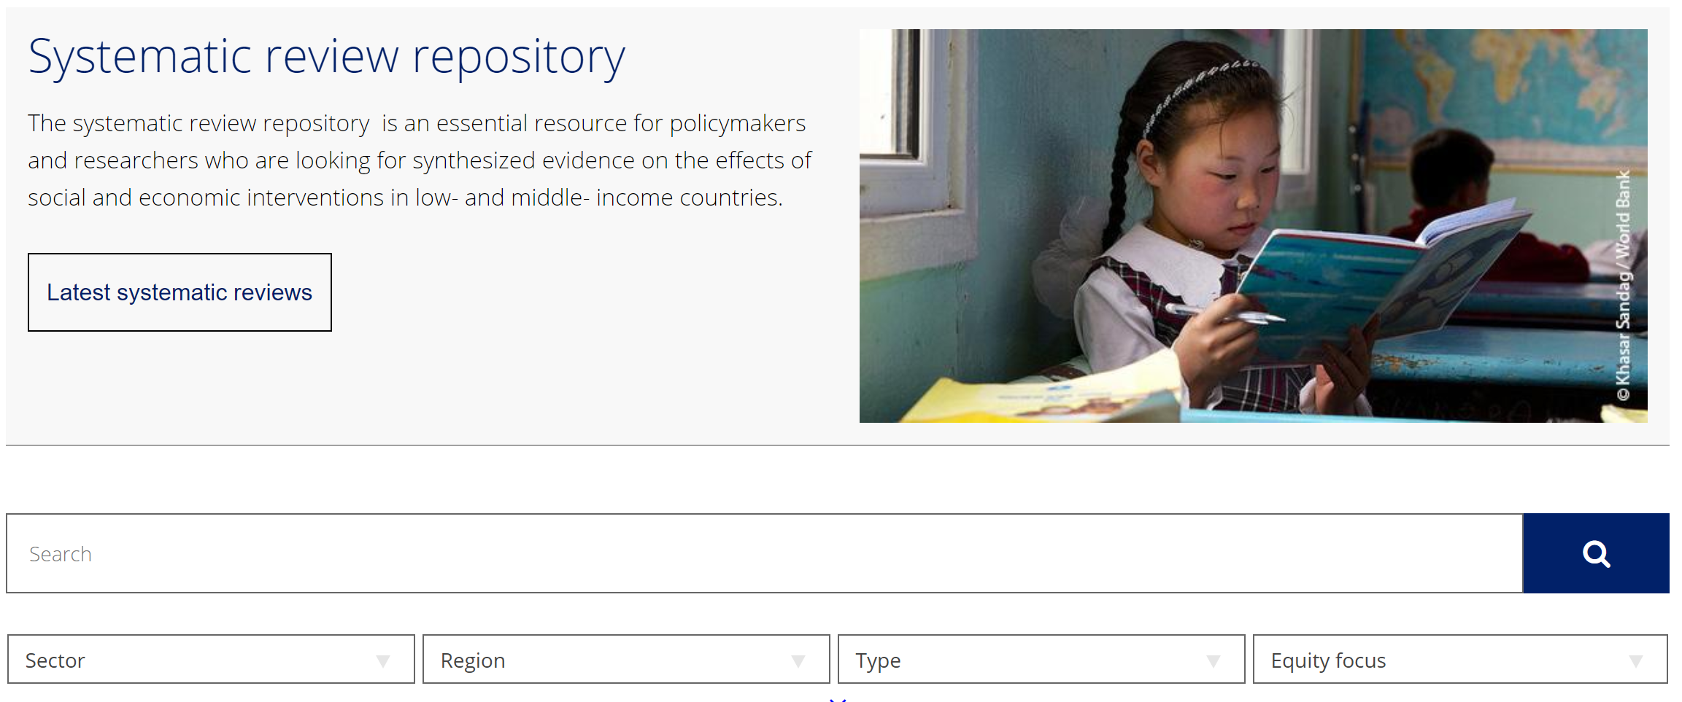
…and the use of qual methods to strengthen quant SRs

Slide 31
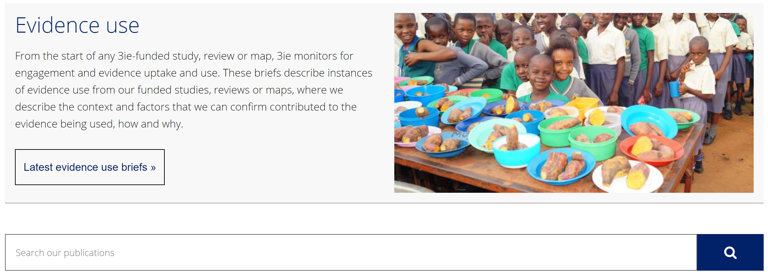
…and the evidence uptake and use of the findings
3ie applies contribution tracing to answer:
Did actors use evidence?
Did they use evidence that we funded?
What were the mechanisms for how it was used?
Do we have the info available to test the claim?
What is our level of confidence in the claim?
Mixed method assessment of testable steps in the contribution pathway
Notes:
About contribution tracing:
-it is a theory-based approach, based on process tracing and Bayesian updating
-
Articulate a testable contribution claim
Develop a targeted data collection strategy
Assign type 1 error and sensitivity
Hold a contribution trial (peer-review mechanism)
Collect data
Organise the findings and update confidence in contribution claim (0-0.99, starts at 0.5)

Slide 32
Presentation outline
Impact evaluation and causal inference
Incorporating qualitative and mixed methods (examples from the field)
3ie online resources and repositories
Open discussion/Q&A

Slide 34
Who we are & what we do
3ie is a member-based international NGO promoting evidence-informed development policies and programmes.
Grant maker, producer and standard setter for policy-relevant impact evaluations, systematic reviews, evidence gap maps, evidence syntheses and replication studies focussed on low- and middle-income countries
Convener of forums to build a culture of evaluation, capacity to undertake impact evaluations and reviews and commitment to evidence-informed decision-making
Producer of knowledge products for policymakers, programme managers, researchers, civil society, the media and donors
Champion of Global Public Evidence Goods
“What works, for whom, why, and at what cost?”
Notes:
3ie is a member-based international NGO promoting evidence-informed development policies and programs. We have offices in Washington DC, London, and Delhi.
As an organisation, we believe evidence-informed decision-making will make development more effective and help improve the living standards. We support studies and reviews that examine what works, for whom, why and at what cost in low- and middle-income countries (L&MICs). We are also a global advocate for the generation and use of quality evidence in development decision-making.
While a large effort has been made for development, the global community recognizes huge evidence gap related in part to the lack of high quality impact evaluations; 2) 3ie is created to help fill the gap.
We are primarily a grant maker set up by major development donors to help fill the large gaps in quality evidence available for international development decision-making.
We fund impact evaluations, systematic reviews, evidence syntheses and evidence gap maps and replication studies focused on low- and middle-income countries.
We set high standards in terms of our grant making. We fund experimental and quasi-experimental impact evaluations that are policy-relevant, use innovative approaches, are gender responsive and equity focussed. We fund mixed-method studies that draw on quantitative and qualitative research and answer the question of what works, what doesn’t, for whom, how and at what cost. We are also leaders in funding and producing systematic reviews.
We convene forums for building the capacity for evaluation and for promoting conversations and collaborations between researchers, programme managers and policymakers. We organise international conferences, seminars and workshops around various aspects of impact evaluations. We also have a significant online presence for sustained and deep engagement with our stakeholders. We engage very closely with our members who form a diverse community united by the commitment to use evidence for the improvement of development policies and programmes. Our members are public and private donors, NGOs, and government agencies from low- and middle-income countries.
We produce a range of knowledge products:
--scoping papers and evidence gap maps that inform how we develop and fund our grant-making and determine funding priorities for the organisation.
-- impact evaluation report series
--systematic reviews and systematic review summary series
--replication report series
--expert guidance and resources for each of our main audiences
We also maintain and update out databases.

Slide 35
Supplementary slides

Slide 36
Examples from the field
Country | Topic(s) | Qual purpose(s) | Qual method(s) | Contribution
Zambia | Gender, Empowerment | Context, triangulation, critique measures | In-depth interviews | Insights on quant measures of female bargaining power
Bangladesh | Nutrition, Livelihoods | Inform study design | (Reviewing prior) anthropological research | Conduct quantitative analysis with qualitative insight
India | Health | Implementation fidelity, root cause analysis | Focus group discussions, observation, field notes | More nuanced ToC, incl. supply-side constraints, heterogeneity
Vietnam | Gender, Empowerment | Compare beneficiary/ staff views quant v. qual | In-depth interviews, focus group discussions | Beneficiary suggestions for improving intervention design
Mexico | Early child development | Beneficiary perceptions, results interpretation | Interviews, focus group discussions | Insights to refine intervention, improve public understanding
Cambodia | Nutrition | Inform analysis, causal assumptions | Stakeholder interviews, tracer interviews | Alternative perspectives on quant findings
China | Education | Implementation fidelity | Interviews | Observed non-compliance, informing findings
Notes:
Table of examples to be filled in from examples shared by 3ie staff and from the underlying papers in the CEDIL paper. Possibly other sources.
Uttar Pradesh, India:
-Community-led video education to increase vaccination coverage
-Mixed methods RCT
-FGDs, observation based on ToC
-Qualitative data were collected using semi-structured instruments designed for both FGDs and interviews, separately for health workers, mothers, and community members. Instruments were designed based on the study TOC and continually updated to reflect data collected
-The intervention explicitly sought to change knowledge, attitudes, beliefs, and norms about immunization, which at baseline we believed to be significant constraints to immunization. The updated TOC and our findings illustrate that these may not have been the most significant constraints, or they cannot be addressed in isolation.
-Results of in-depth probing during FGDs and ASHA interviews suggest this belief continues to persist in some sub-communities in this district and is more strongly held among older generations, who tend to be decision-makers in traditional households, as well as in Muslim communities.
Zambia:
-Women’s empowerment (child grant program); a poverty-targeted, unconditional transfer given to mothers or primary caregivers of young children aged zero to five.
-The qualitative component consisted of 30 IDIs with women and 10 IDIs with male partners or other decision makers in the household of the women interviewed, collected at one point in time in the Kaputa District
-The women and their partners were purposefully sampled from the longitudinal quantitative sample stratified on three indicators: (1) marital status (married and cohabiting versus unmarried), 6 (2) changes in quantitative measures of decision making over time (as a proxy for changes in women’s empowerment), and (3) treatment or control grou
-The combined methods show that there is significant room
for improvement of measurement of empowerment, including
of women’s decision-making indicators. In particular, findings
show that although women often state they make decisions
(either solely or jointly), they also acknowledge that if there
is a disagreement or difference of opinion women’s preferences
are often second to men’s, calling into question the validity of
empirical measures to accurately capture the concept of ‘‘the
ultimate decision maker.” In addition, research suggests that
men and women differ in their perceptions of decision making,
indicating a divergence of opinion or other sources of bias
with creates conflicting reports
Mexico (Cardenas):
-many of the beneficiaries were participating, without having enough information about the benefits they and their children could receive, because acquaintances had recommended it.
-Implementation of the PEI for almost two decades without an impact evaluation has resulted in the institutionalisation of practices and criteria without adequate evidence to support them. Based on the information collected (qualitative and quantitative), the interpretation of findings and interactions with public officials, we identified the following implications as key aspects to be considered in a potential redesign of the programme
Cambodia (DARA):
-At the household level, food consumption was analysed through the IDDS for THR beneficiaries only. This indicator doesn’t show a significant positive effect of the programme. However, it is believed that the period the survey was carried out negatively influenced the results. Qualitative interviews showed that THR allows beneficiaries to mitigate the loss of diet diversity they experience during the lean season. It is, therefore, a positive impact on the reduction of negative coping strategies.
-The study revealed higher asset scores for beneficiaries than for non beneficiaries, and lower representation of beneficiaries into the two poorest categories of households, in benefit of the two wealthiest ones. However, according to qualitative interviews, this difference is more likely to be due to a reduction of the sale of assets, as a coping strategy, than to an investment of eventual food savings or extra income in assets
-The qualitative data collection mainly focused on interviews with stakeholder and focus group discussions. Stakeholder interviews include staff from relevant line ministries, UN, NGO and the donor community. The purpose of these interviews is to collect data on more strategic issues that affect school feeding, such as national development plans, sectoral strategies or other specific interventions that may affect the school feeding interventions. The focus groups discussions will target both beneficiaries living in targeted communes and non-beneficiaries (within control groups). The purpose of these discussions is to understand and explain the causalities and assumptions of the school feeding programme, i.e. why is it successful, why do children attend school, to what extend does it have an effect on household economies and how does that affect dispositions related to education, etc. Topics and interview guides relate to the five categories of the household survey questionnaire (See Annex 7 for Topics list). Tracer interviews will be conducted with household members that have graduated successfully form primary education cycles. The purpose of this interview-approach is to „trace‟ the importance of school feeding among graduates.
Vietnam:
-women in both training conditions indicated that without the participation of their husbands the relational dynamics would not change. Similar ideas were expressed by the TYM staff who appreciated the training in general but also underscored the importance of involving the husbands in the offered training to encourage active participation in the training sessions, the application of the taught knowledge and skills, and gender equality.
Bangladesh (White 2009):
First, use of qualitative data means a wide range of activities, not just arranging for some focus groups (in my view one of the weaker forms of qualitative data, unless done really well). It includes, for example, reading of anthropological and political literature of the intervention context to inform evaluation design. In the Bangladesh case, identification of the ‘mother- in- law’ effect came from reading anthropolo gical literature (notably White, 1992). This insight led us to unpack the household roster section of the questionnaire to identify those women living with their mother in law (e.g. daughter-in- law of household head, where spouse of household head also pre sent, spouse of household head, where mother of head also present, and sister- in- law of household head, where mother of head also present), and so carry out quantitative analysis informed by a qualitative insight. Second, the people targeted have to be the right ones. The program targeted the mothers of young children. But mothers are frequently not the decision makers, and rarely the sole decision makers, with respect to the health and nutrition of their children. For a start, women do not go to market in rural Bangladesh; it is men who do the shopping. And for women in joint households – meaning they live with their mother- in- law – as a sizeable minority do, then the mother-in- law heads the women’s domain. Indeed, project participation rates are significantly lower for women living with their mother- in-law in more conservative parts of the country.

Slide 37
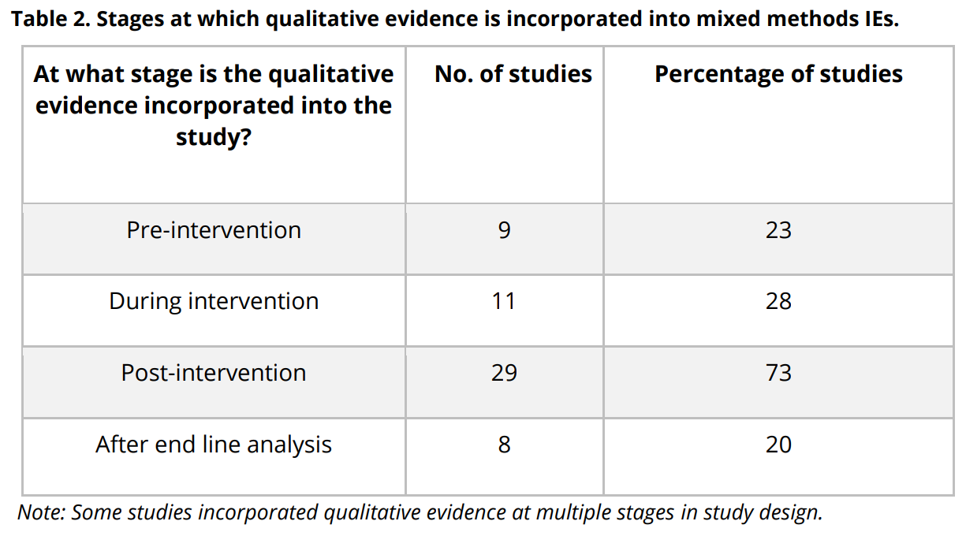
Stages of incorporating qualitative methods
https://cedilprogramme.org/wp-content/uploads/2018/08/Inception-Paper-No-5-1.pdf

